Slide 1

Project Presentation on Develop a Data Sentiment Analyzer in Machine Learning
Bachelor of Technology
in
Computer Engineering
Presented By: Kaustubh Kulkarni (2014111506) Guided By :- Prof. Rohini Khalkar
Sandesh Pathak (2014111507)
Chaitanya Raskar (2014111508)
Bharati Vidhyapeeth Deemed to be University, College of Engineering, Pune.
Notes:
NOTE: Want a different image on this slide? Select the picture and delete it. Now click the Pictures icon in the placeholder to insert your own image.

Slide 2
Develop a Data Sentiment Analyzer in Machine Learning
Introduction
Sentiment Analysis is a Natural Language Processing technique to determine the sentiment or opinion of a given text. A sentiment analysis model can predict whether a given text data is positive, negative, or neutral by extracting meaning from the natural language and assigning it to a numerical score.
Sentiment analysis is used by various organizations to understand the sentiment of their customers, using reviews, social media conversations, and to more fast and accurate business decisions accordingly.

Slide 3
Why do we need sentiment analysis?
Sentiment analysis serves as a fundamental aspect of dealing with customers on online portals and websites for the companies. They do this all the time to classify a comment as a query, complaint, suggestion, opinion, or just love for a product. This way they can easily sort through the comments or questions and prioritize what they need to handle first and even order them in a way that looks better. Companies sometimes even try to delete content that has a negative sentiment attached to it.
Emotion understanding and sentiment analysis play a huge role in collaborative filtering based recommendation systems. Grouping together people who have similar reactions to a certain product and showing them related products. Like recommending movies to people by grouping them with others that have similar perceptions for a certain show or movie.

Slide 4
Step 1:Tokanization
The movie was great!
The
Movie
Was
Great
!
Step 2:Cleaning the data- Remove the special characters
The
Movie
Was
Great
!

Slide 5
Step 3: Removing stop words
The
Movie
Was
Great
!
Step 4: Classification- Positive +1, Negative -1, Neutral 0
The
Movie
Was
Great
!
Apply Supervised Algorithm for Classification
Train the model with bags of words or lexicons, and test it on the analysing statement.
Movie=0 Great=+1

Slide 6
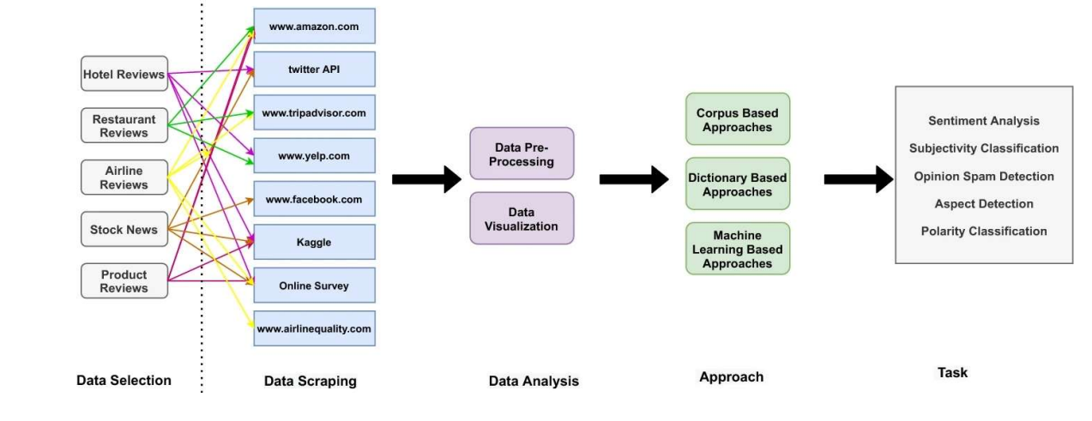
Proposed System Architecture
Architecture of Sentiment Analysis System

Slide 7
Proposed System Methodology:
1.Extraction Of Data:
In order to extract the opinion first of all data is selected and extracted from twitter in the form of tweets. After selecting the data set of the tweets, these tweets were cleaned from emoticons, unnecessary punctuation marks and a database was created to store this data in a specific transformed structure.
2.Pre-processing Of Data:
Removing Html tags and URLs: Html tags and urls often have minimum sentiments thus they are removed from tweets Using regular expressions.
3.Conversion to lowercase:
To maintain uniformity all the tweets are converted to lowercase. This will benefit avert inconsistency in data. Python provides a function called lower() to convert sentences to lowercase.
4.Tokenization:
Tokenization is the process of converting text into tokens before transforming it into vectors. It is also easier to filter out unnecessary tokens. For example, a document into paragraphs or sentences into words. In this case we are tokenising the reviews into words.

Slide 8
5.Stop words removal:
Stop words are the most commonly occurring words which are not relevant in the context of the data and do not contribute any deeper meaning to the phrase. In this case contain no sentiment. NLTK provide a library used for this. "This is a sample sentence, showing off the stop words filtration."
['This', 'is', 'a', 'sample', 'sentence', ',', 'showing', 'off', 'the', 'stop', 'words', 'filtration', '.']
6.Feature Extraction:
Text data demands a special measure before you train the model. Words after tokenization are encoded as integers or floating point values for feeding input to machine learning algorithm. This practice is described as vectorization or feature extraction.
7.Result Analysis:
Here the accuracy of different classifiers are shown among which the best classifier with highest accuracy percent is the chosen. Some factors such as f-score, mean, variance etc., also accounts for consideration of the classifiers.

Slide 9
Algorithms
VADER algorithm is a supervised learning algorithm.
VADER (Valence Aware Dictionary and sEntiment Reasoner) is a lexicon and rule-based sentiment analysis tool that is specifically attuned to sentiments expressed in social media.
VADER uses a combination of A sentiment lexicon is a list of lexical features (e.g., words) which are generally labeled according to their semantic orientation as either positive or negative.
VADER not only tells about the Positivity and Negativity score but also tells us about how positive or negative a sentiment is.

Slide 10
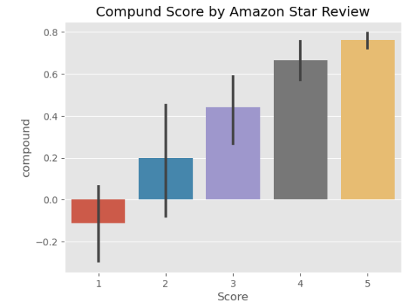
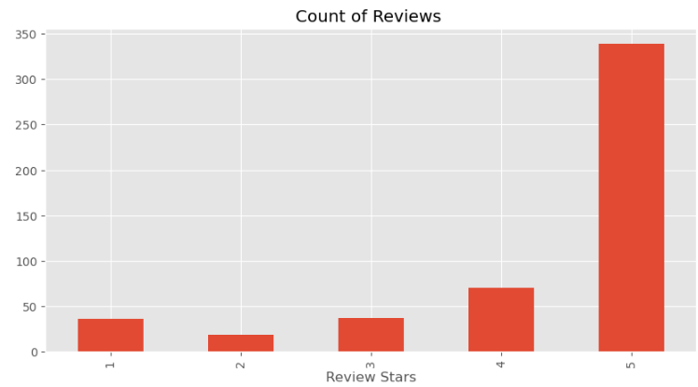
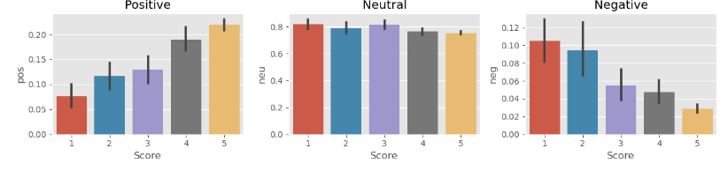
Implementation:

Slide 11
Conclusion
The primary objective of this work is to investigate and complete classification methods with their advantage and disadvantages in sentiment analysis.
Classification using Vader and SVM algorithms are commonly used as benchmarks against which newly proposed approaches can be compared.
The future work will consist of continuously expanding the comparison area with additional findings.
The subsequent challenges illustrate that sentiment analysis is still a relatively unexplored subject of study.
The most common approach is machine learning, a method that needs a significant data set for training and learning the aspects and sentiments associated. Also, models tend to target a simple global classification of reviews, rather than rating individual aspects of the reviewed product.
Only a few of the methods are able to reach a somewhat high level of accuracy. Thus, the solutions for sentiment analysis still have a long way to go before reaching the confidence level demanded by practical applications.

